Slide 1
Partial face recognisation using core feature of face PROJECT GUIDE : KRISHNENDU.S.NAIR
Group members:
Priyesh Sharad Patil
Karthik Pillai
Jayesh Ganesh Patil

Slide 2
CONTENTS
Introduction
Problem Definition
Scope of the Project
2.Literature Survey
Existing System
Methodology
3.Hardware and Software requirements
4. Implementation
5.Application
6. Advantages and limitation
7. Conclusion
8. References

Slide 3
INTRODUCTION
Biometrics recognizing
C# CODE
Attendance of student/employee
This is a lengthy process and takes a lot of time and effort
lot of disturbance and interruption ,human error

Slide 4
LITERATURE SURVEY
The physiological characteristics are related to the shape of the body
organization to be effective, it needs accurate and fast means of recording the performance of the people inside this organization
Appearance based
Model based
Template based
Neural Networks

Slide 5
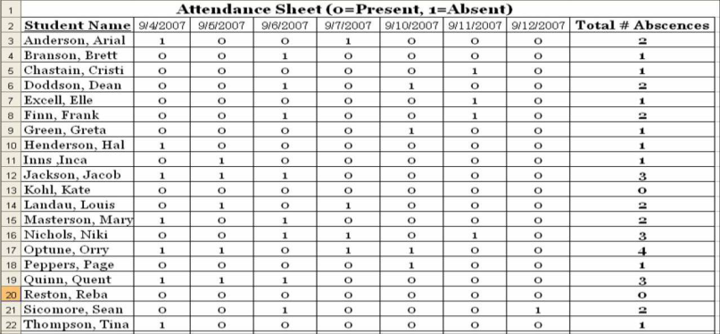
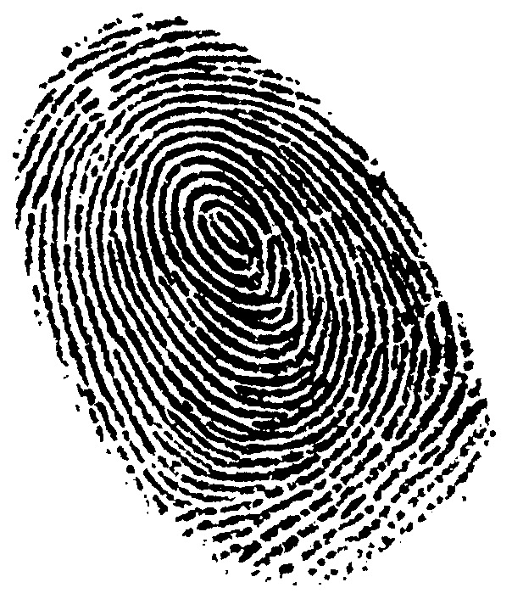
EXISTING SYSTEM
1)Attendance taken manually
old version method for the
attendance system.
attendance by call the person name
and tick in the attendance register
2)Finger print
Identification method looks at the pattern
found.
The pattern of friction ridges and valleys
On an individuals are unique.

Slide 6
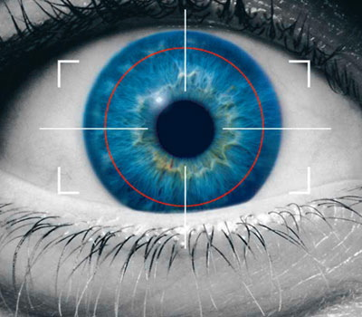
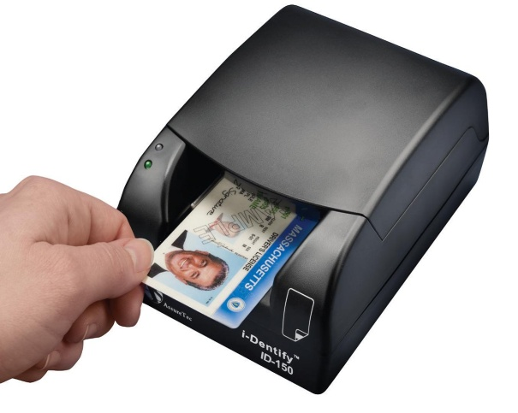
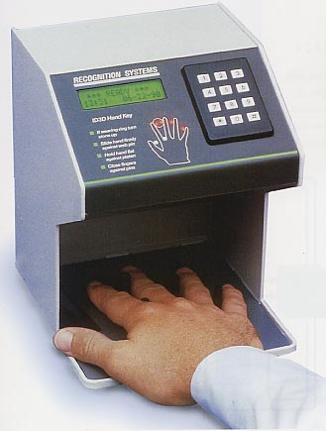
EXISTING SYSTEM
3) Retina scan
The retina scan involves analyzing the layer of blood vessels situated at the back of eye.
The pattern remain same throughout the
.
Low intensity light use for image.
The magnetic strip on the id card is scanned by a computer and information is collected and at the same time attendance is marked.
4) ID card scanning system
5) Hand geometry
Analysis and measure shape of hand.
Length , width , thickness, and surface.

Slide 7
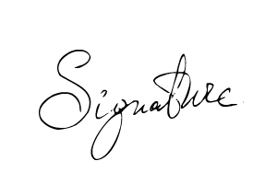
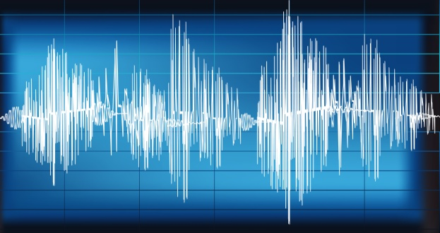
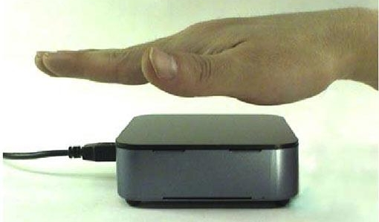
EXISTING SYSTEM
6) Signature
Verification analyzes the way user sign his name.
Features such as speed ,velocity and pressure.
7)Voice
Voice authentication is based on voice to print authentication where complex technology transform voice into text.
8)Palm vein authentication
System used infrared beam to penetrate user hand as it is waved over the system.
This method has high level of authentication accuracy

Slide 8
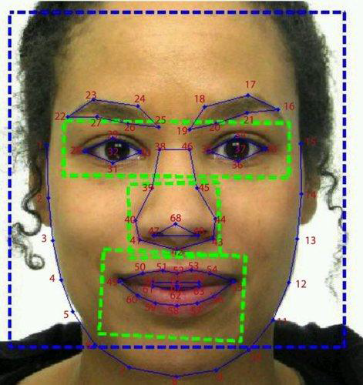
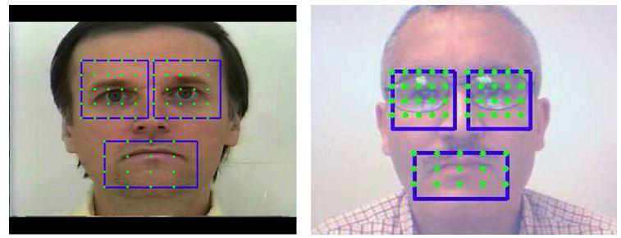
FACE RECOGNITION PROCESS
1)Acquiring a sample
The sensor might be a camera
and the observation is a
snapshot picture
2)Extracting Features
the relevant data is extracted from
the predefined captured sample
software where algorithms
use unique features is enrolled

Slide 9
FACE RECOGNITION PROCESS
Comparision of templates
Image acquisition module is to seek and then extracts a region which contains only the face.
Declaring match The face recognition module contains of preprocessing, feature extraction, and classification sub-modules. The input to the face recognition/verification module

Slide 10

WHAT IS OPEN CV
Open source library of functions relating to computer vision.
Cross-platform (Linux, OS X, Win2K, Win XP).
Originally developed by Intel.

Slide 11
USES
Object Identification & Recognition
(content-based image retrieval)‏
Face recognition
Gesture recognition
Ego-motion
(camera stabilization)‏
Human Computer Interface
(how to input/output visual information)‏
Image Processing
(image restoration, scene reconstruction)‏

Slide 12
HARDWARE AND SOFTWARE REQUIREMENT
HARDWARE
1.66 GHz Pentium Processor or Intel compatible processor.
2GB RAM.
80 GB free hard disk space.
Web Camera
SOFTWARE
Visual Studio 2008(Dot Net framework)
Dot net Frame work
Microsoft access 2007

Slide 13
IMPLEMENTATION
Gathering Hardware and Software Requirements
Assembling the gathered Hardware
Coding
For user interface
For face detection
For face recognition
Testing the whole Project

Slide 14
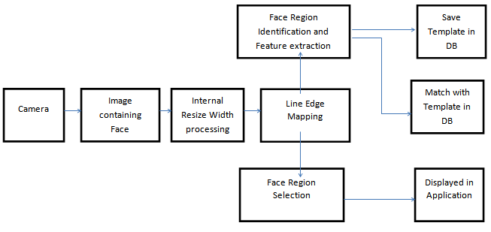
IMPLEMENTATION BLOCK DIAGRAM

Slide 15
ALGORITHM
Emgu
Harr cascade
What is emgu?
Emgu CV is a cross-platform image-processing library.
It is closely related to OpenCV because Emgu CV is a .NET wrapper to OpenCV.
We can say Emgu CV is OpenCV in .NET. The amazing wrapper makes it possible for OpenCV functions to be called from .NET programming languages. C#, VB, IronPython,

Slide 16
ADVANTAGES OF EMGU CV
Cross-platform
Emgu CV is totally written in C#.
The advantage it brings is that it is compatible with Mono. Linux PC, Android, iOS, and Mac OS X. Headers can be simply included in managed C++ implementation, but great effort has been taken to build this pure C# implementation to achieve cross-platform.
Cross-language support with examples
Emgu CV is able to run in multiple language environments, including VB.NET.
IronPython, C#, and C++. Several instances have been provided on the official.

Slide 17
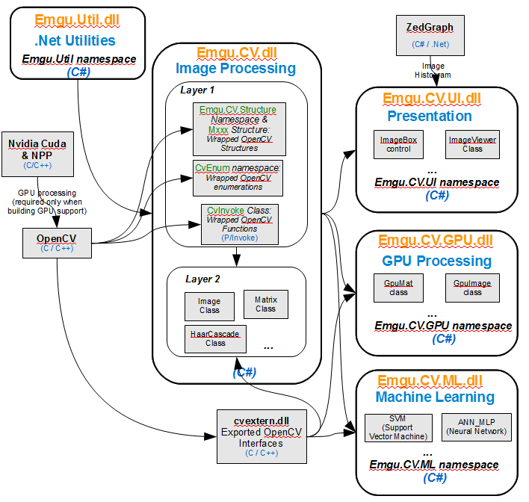
EMGU FLOW CHART

Slide 18
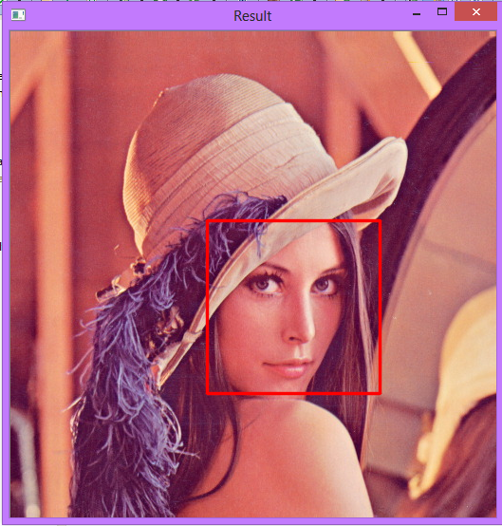
ADVANTAGES OF HARR CASCADE
What is Harr Cascade?
It is a machine learning based approach
where a cascade function is trained from
a lot of positive and negative images.
It is then used to detect objects in other images.
the algorithm needs a lot of positive images (images of faces) and negative images (images without faces) to train the classifier.

Slide 19
APPLICATION
Counting of attendance in schools, colleges, offices etc.
Security/Counterterrorism: Access control, comparing surveillance images to Know terrorist
Voter verification.
Gaming consoles eg. Xbox 360 Kinect.
Banking using ATM.
Residential Security
Identification Of guardian Picking up children from school.

Slide 20
ADVANTAGES AND LIMITATION
Advantages
There are many benefits to face recognition systems such as its convinence and Social acceptability. all you need is your picture taken for it to work.
Face recognition is easy to use and in many cases it can be performed without a Person even knowing.
Limitation
Changes in acquisition environment reduce matching accuracy.
Changes in physiological characteristics reduce matching accuracy.

Slide 21
CONCLUSION
Face recognition technologies have been associated generally with very costly top secure application Today the secure technologies have evolved and the cost of equipment is going dramatically due to the integration and the increase processing power. Certain application of face recognition technology are now cost effective , reliable and highly accurate.

Slide 22
REFERENCES
1) H. Bay, T. Tuytelaars, and L. Van Gool. Surf: Speeded up robust
features. ECCV, 2006.
2)P. N. Belhumeur, J. P. Hespanha, and D. J. Kriegman. Eigenfaces vs.
fisherfaces: Recognition using class specific linear projection. PAMI,
1997.
3)F. L. Bookstein. Principal warps: Thin-plate splines and the decomposition
of deformations. PAMI, 1989.
4) W. Chen and Y. Gao. Recognizing partially occluded faces from a
single sample per class using string-based matching. In ECCV. 2010.
5) H. Chui and A. Rangarajan. A new point matching algorithm for
non-rigid registration. CVIU, 2003.
6) D. Conte, P. Foggia, C. Sansone, and M. Vento. Thirty years of graph
matching in pattern recognition. PAMI, 2004.
7)T. F. Cootes, G. J. Edwards, and C. J. Taylor. Active appearance
models. PAMI, 2001.
8)E. Elhamifar and R. Vidal. Robust classification using structured
sparse representation. In CVPR, 2011.

Slide 23
Thank you….!!!!!

